Slide 1

Managing panic attacks
Jackie Middleton
Head of Student Mental Health

Slide 2
What are panic attacks?
Stress response of fear and anxiety
It may feel like you will pass out but this is very unlikely
Don’t last very long (5-20 minutes)
Not dangerous

Slide 3
What do panic attacks look like?
Feeling of being out of control, out of touch with your body
Dysregulated breathing
Raised heartbeat and blood pressure
Feeling shaky/wobbly
Light-headed, sweating
Emotional
Feeling sick or having stomach cramps
Chest pain

Slide 4
How to prevent panic attacks
Good sleep and eating habits
Exercise and spend time outdoors
Mindfulness
Practice breathing, grounding and relaxation exercises regularly so that you can employ these in times of stress
Schedule studying and work to include breaks, varying tasks/topics and appropriate ending times
The Student Learning Advisory Service has a lot of advice and guidance on academic skills and managing your time effectively

Slide 5
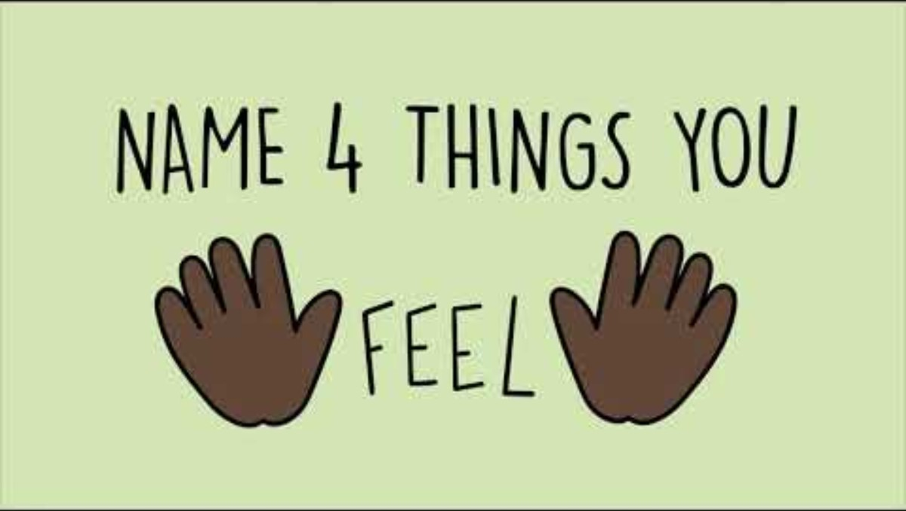

Slide 6
How to support someone having a panic attack
Take them to a quiet space
Try to get them to regulate their breathing
  Get them to breathe with you
  Count to 3 seconds in and count to 3 seconds out, then for 5 seconds…
Shift their focus/use grounding techniques
  Ask them to describe other senses – what can they hear, see, feel
  Ask them innocuous questions
  Get them to stamp their feet
  Eat something with a strong taste – sweets, chewing gum etc
Reassure them. Explain next steps where appropriate
Tell them that this will pass soon

Slide 7
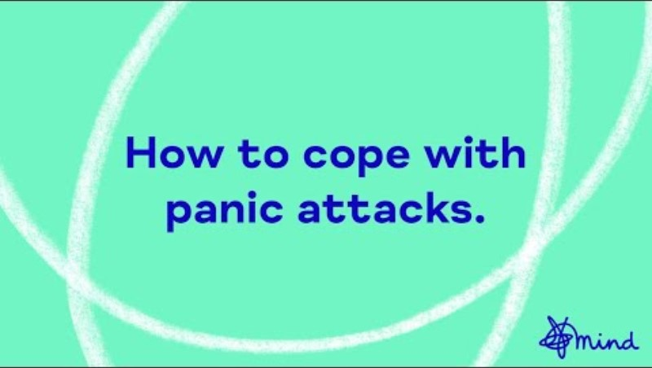

Slide 8
Further support
If student is not calming down after 10-15 minutes…
First Aider (Campus Security 01227 823333)
111/999
Further mental health support
Student Support and Wellbeing
Out of hours support
  Nursing Services
  Spectrum Life (online, text, phone) – Urgent Support webpage
Mitigation
Young Minds guidance on panic attacks
NHS Inform page on panic attacks

